Slide 1
FLOODS AND THEIR MANAGEMENT

Slide 2
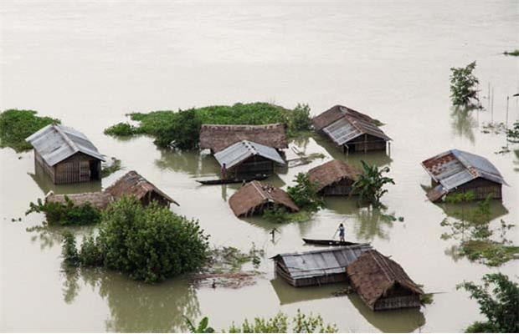
When hazards actually happen and harm life and property we call it disaster.
DISASTERS IN INDIA
Floods, droughts, earthquakes, cyclones and sometimes tsunamis also happen in India.
FLOODS

Slide 3
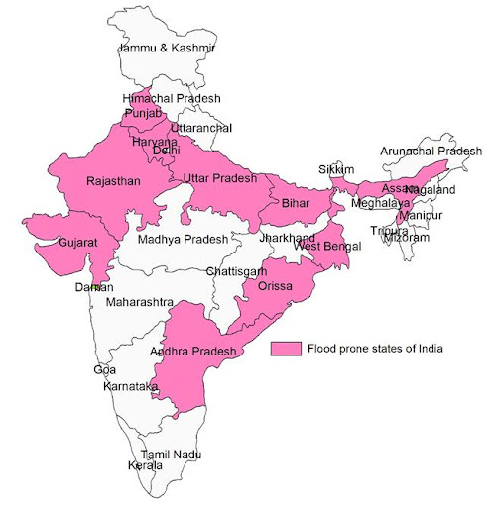

Slide 4
Flood is the overflowing rivers and water reservoirs.
CAUSES OF FLOODS
Heavy rains, cyclones, cloud busts, tsunamis , siltation of rivers and reservoirs.
EFFECTS
Loss of human beings and livestock
Shortage of safe drinking water
Loss of property and crops
Damage caused to rails, roads, dam, crops, uprooting of trees
Landslide and soil erosion.
Loss of vehicles, machinery
Utilities such as water supply, sewerage, communication lines, transport , network are disrupted.
Spread of diseases after flood is over.

Slide 5
MANAGEMANT
Afforestation should be done ,construction of dams’, identification of flood prone area.
Flood forecasting – Alerting people to move to safe places from areas of submergence
Flood warnings- In India central water commission, irrigation and flood control department
Land use planning- Construction of roads, railways, houses on elevated area
What people should do?
Remain alert upon flood forecasting information.
Move food, water and valuables to elevated places.
Store extra food and water in case of emergency.
Don’t touch any electric wire.
Take special care of small children and old persons and physically challenged .

Slide 6
Thank you

